Slide 1
CS595-01 Final Project: Big data pipeline (ETL)
Created by:
Sameer Gadne - A20392126

Slide 2
Overview
Application subject area:
Entertainment & Movies
End Goal:
Build a data processing pipeline using Big Data technologies to ingest, curate, transform, load and use techniques to explore data and derive insights on Movies data from IMDB.
Approach:
Data Ingestion: HDFS commands to move data on to Hadoop ecosystem
Data Curation & Transformation: Spark SQL (using Data Frames)
Database: Hive
Data Mining & Analysis: HQL on Big Data and R

Slide 3
Dataset details
Data set Source:
IMDB & Movie Lens Movies dataset from Kaggle
https://www.kaggle.com/tomiandrep/imdb-filmid/data
Data set of 1,000 most popular movies on IMDB in the 10 years [2006-2016]. The data points included are: Title, Genre, Description, Director, Actors, Year, Runtime, Rating, Votes, Revenue, Metascore.
https://www.kaggle.com/rounakbanik/the-movies-dataset/data
The main Movies Metadata file. Contains information on 45,000 movies featured in the Full Movie Lens dataset. Features include posters, backdrops, budget, revenue, release dates, languages, production countries and companies.

Slide 4
Source schema
Movie Lens Dataset
IMDB Dataset

Slide 5
Challenges
Issues identified:
Missing & Null Values
For important attributes/features such as Movie Genre, Release Date, Production Company, Ratings, Runtime etc.
Outliers
Documentary films that do not have all the relevant features/attribute information in Movie Lens dataset
Entity Resolution
De-duplication of records based only on Movie title
Data Fusion
Resolving conflicting values for common attributes/features while merging the datasets

Slide 6
Schema Matching [source]
Movie Lens Dataset
IMDB Dataset

Slide 7
Schema Matching [source TO Target]
(Source) Movie Lens Dataset
(Source) IMDB Dataset
(Target) Dataset

Slide 8
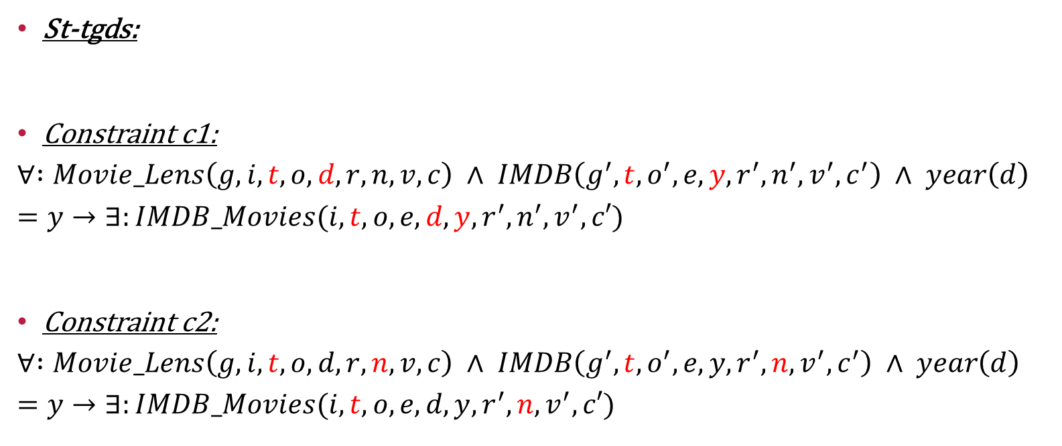
Schema Mapping
St-tgds:
Constraint c1:
$$∀ :Movie_Lens\left(g,i,t,o,d,r,n,v,c\right) ∧ IMDB\left(g^{′},t,o^{′},e,y,r^{′},n^{′},v^{′},c^{′}\right) ∧ year\left(d\right)=y→∃:IMDB_Movies(i,t,o,e,d,y,r^{′},n^{′},v^{′},c′)$$
Constraint c2:
$$∀ :Movie_Lens\left(g,i,t,o,d,r,n,v,c\right) ∧ IMDB\left(g^{′},t,o^{′},e,y,r^{′},n,v^{′},c^{′}\right) ∧ year\left(d\right)=y→∃:IMDB_Movies(i,t,o,e,d,y,r^{′},n,v^{′},c′)$$

Slide 9
Resolution/Approach
Issues identified:
Missing & Null Values
For important attributes/features such as Movie Genre, Release Date, Production Company, Ratings, Runtime etc.
For Date attributes such as Release Date we imputed a default High End Date (9999-12-31 [YYYY-MM-DD])
Outliers
Documentary films that do not have all the relevant features/attribute information in Movie Lens dataset
There were no relevant records in the IMDB dataset corresponding to documentary films from Movie Lens dataset
Entity Resolution
De-duplication of records based only on Movie title
Feature extraction to extract the Release Year from the Release Date attribute in Movie Lens dataset and perform join on Movie Title as well as Movie Release Year or on Movie Title and Runtime between IMDB & Movie Lens (source) datasets
Data Fusion
Resolving conflicting values for common attributes/features while merging the datasets
For Numeric attributes ➔ Average
For String attributes ➔ Trust based (based on attribute from either dataset)
For missing/Null attributes ➔ Use the value from other dataset (if available)

Slide 10
Provenance
For an output tuple t in the result of the query q over the database instance I:
Why Provenance Why(q,t,I):
{{m_{i}, i_{j}}}
Minimal Why Provenance MWhy(q,t,I):
{{m_{i}, i_{j}}}
Provenance Polymials:
m_{i} X i_{j}

Slide 11
Big data processing pipeline/workflow [etl]
Data Mining & Analysis
[R script]
Data Ingestion
(Download files)
Data Ingestion
(Download files)
Data
Post-processing
Copy to Cloud Environment
Data Preprocessing
Data Transformation
Hive table
[IMDB_Movies]

Slide 12
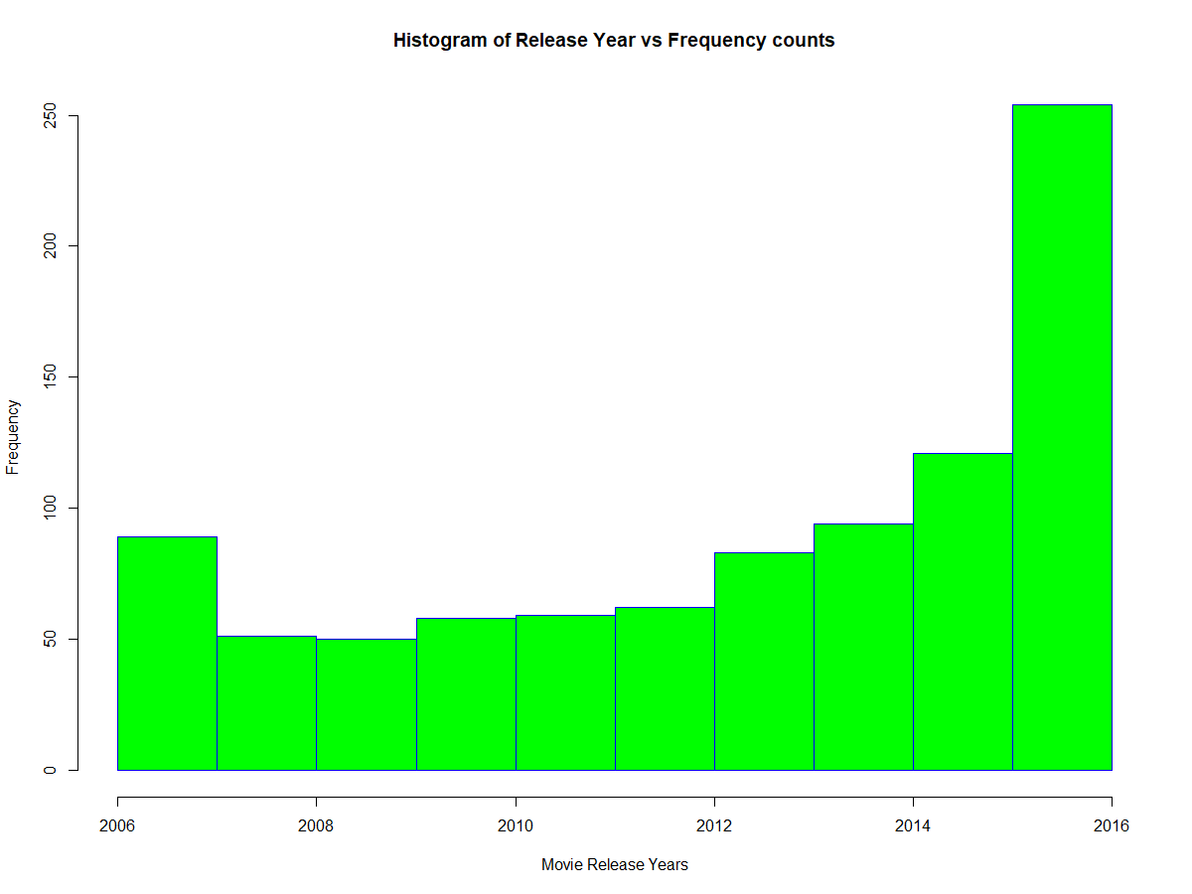
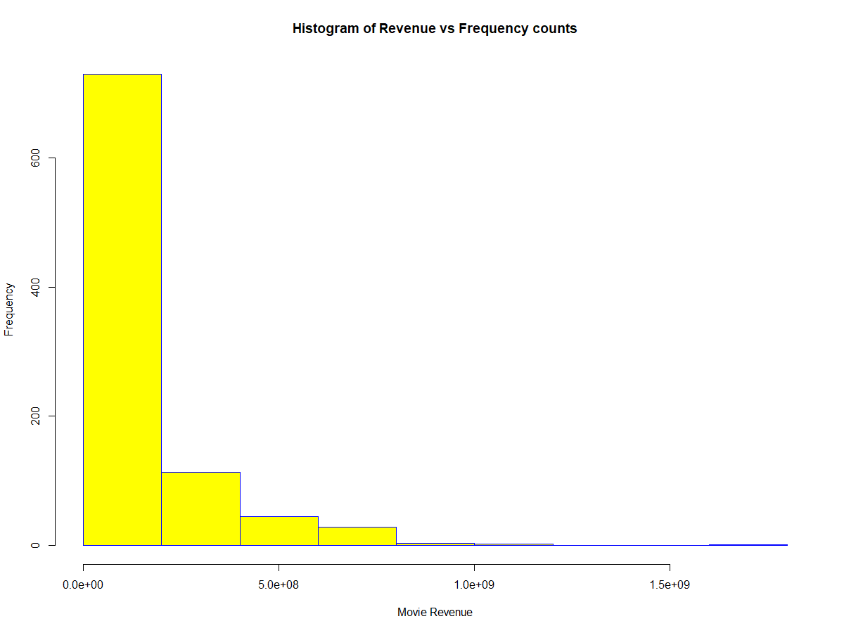
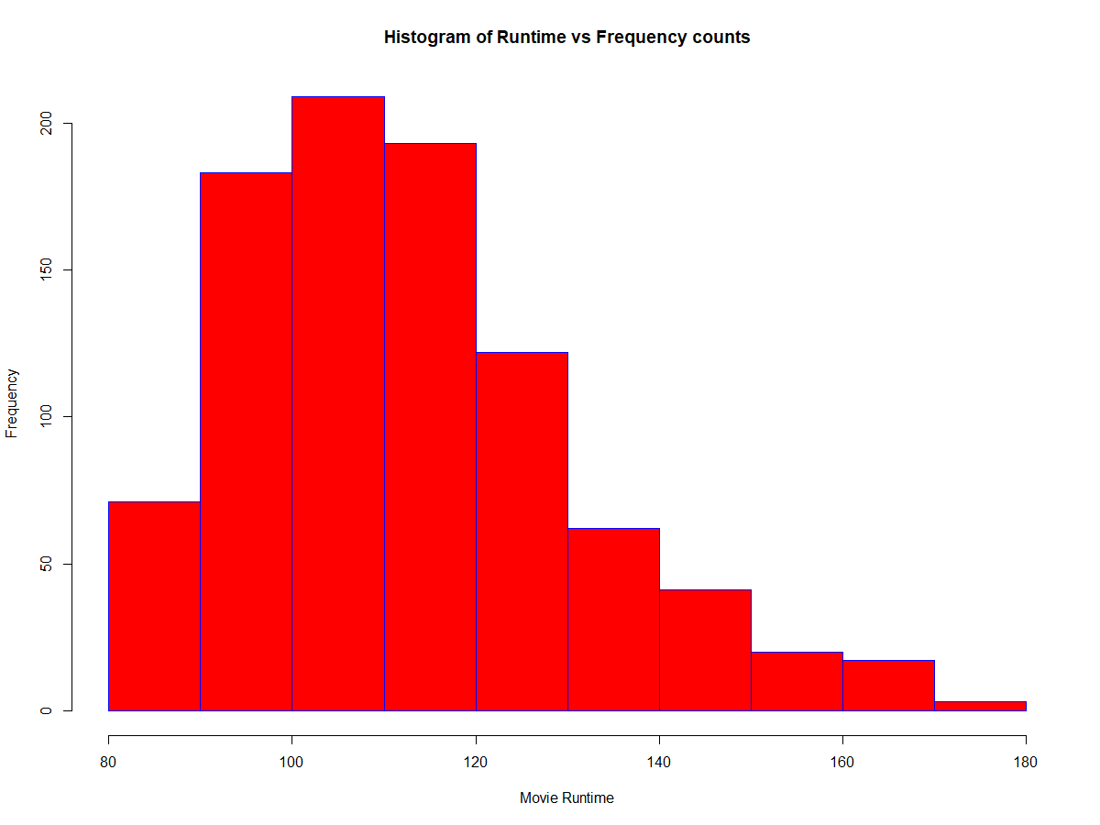
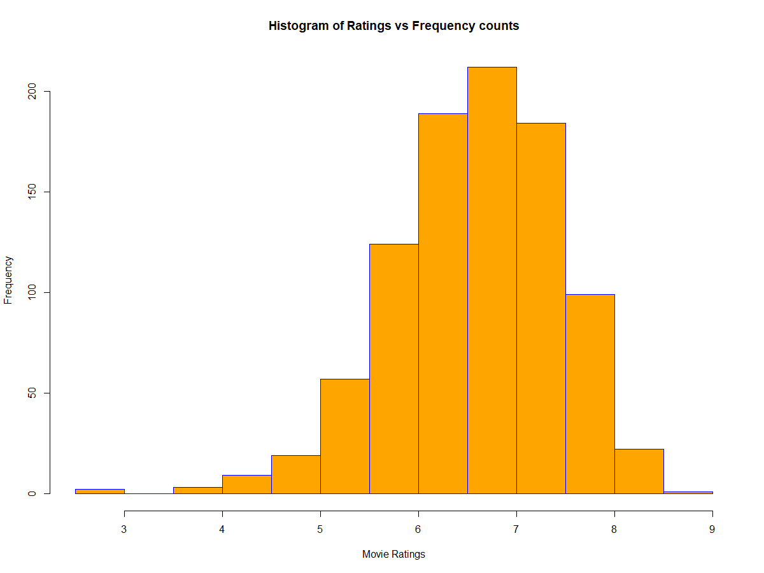
Output/results:

Slide 13
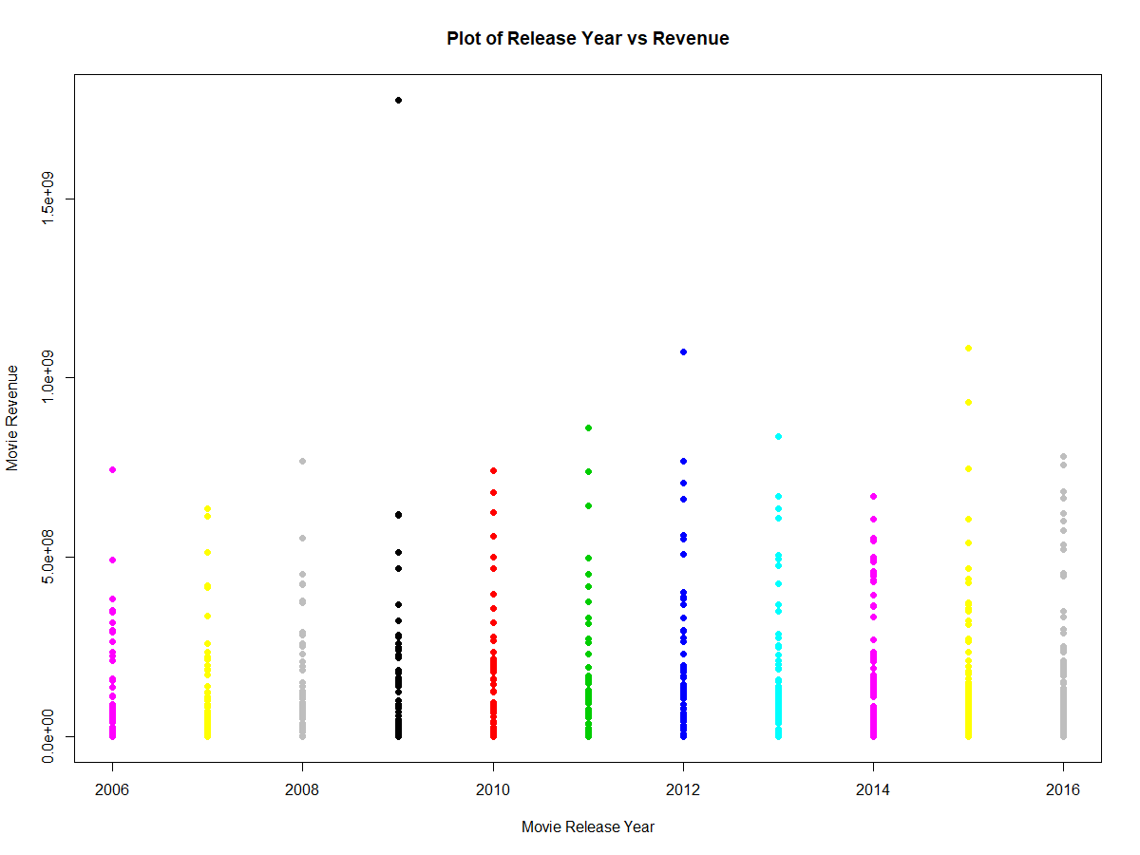
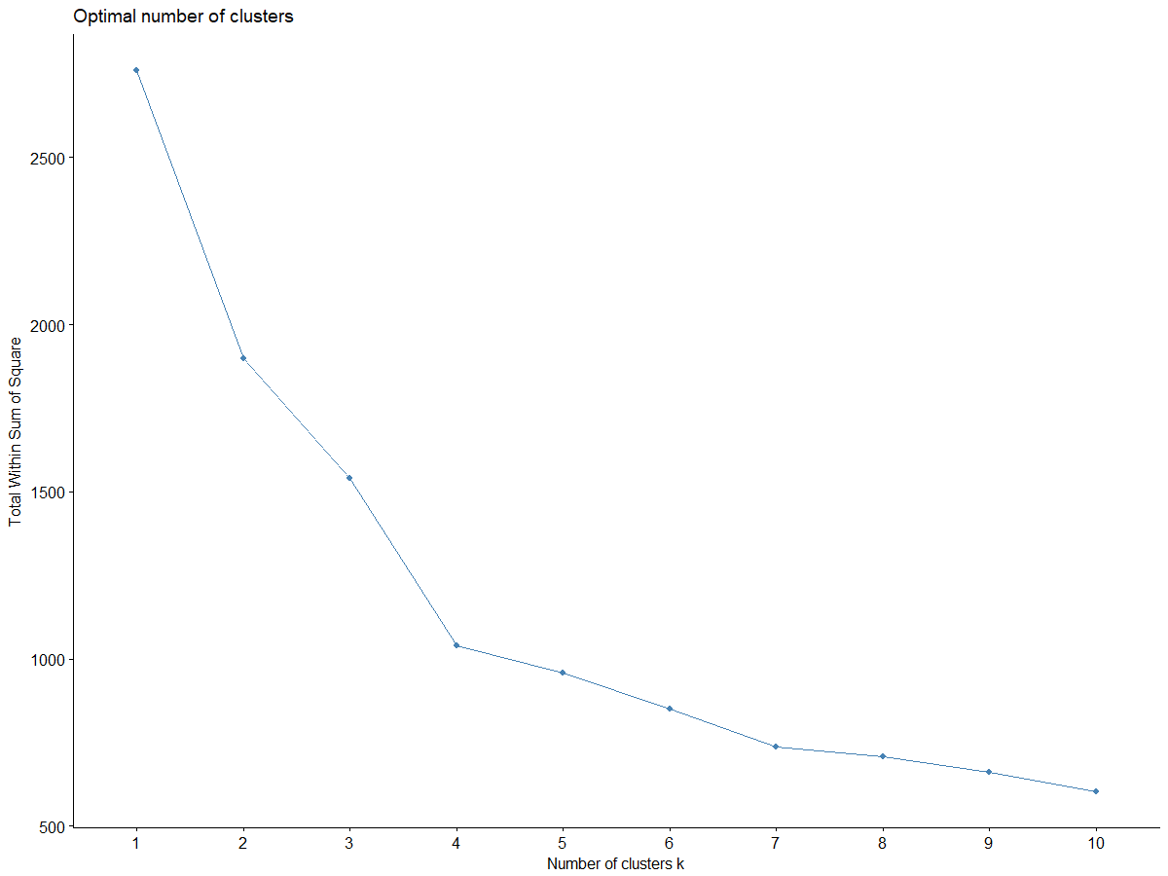
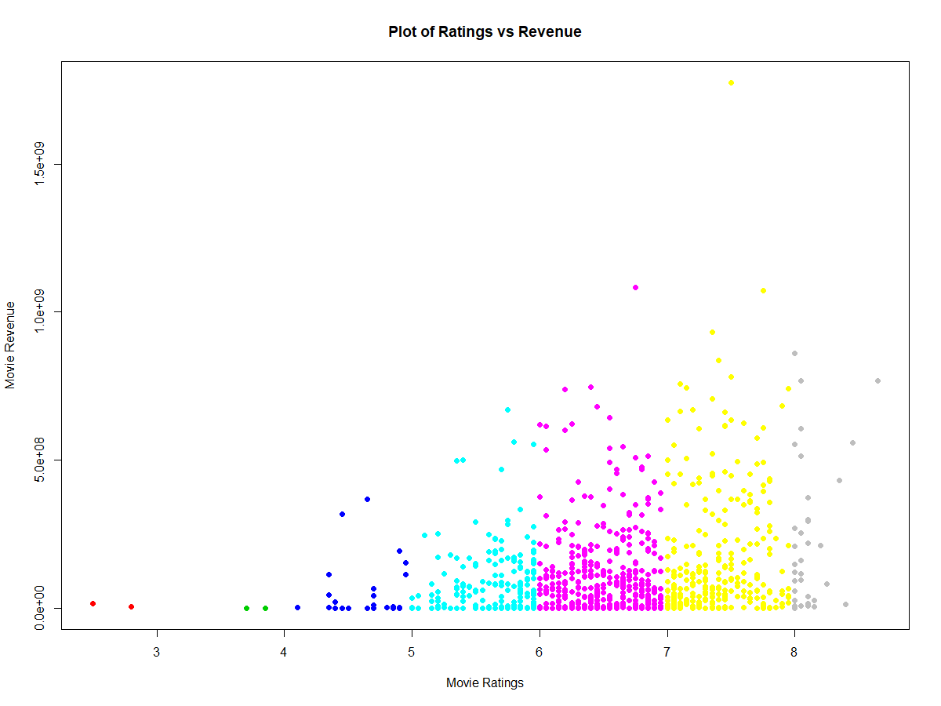
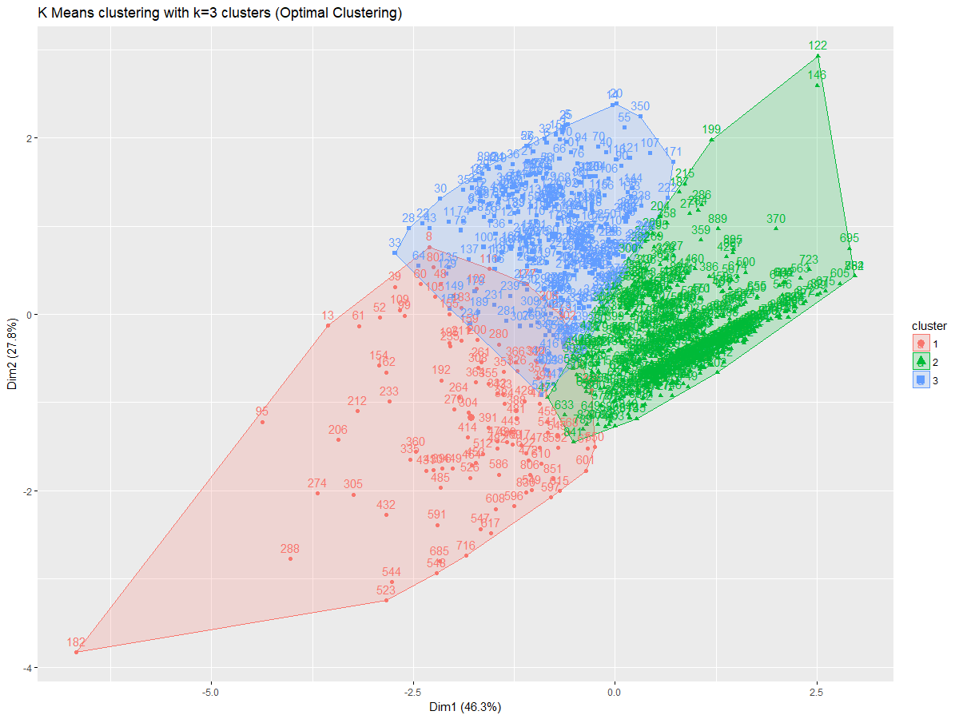
Output/results:

Slide 14
Thank you !

